Slide 1
UML Class Diagram

Slide 2
Agenda
What is a Class Diagram?
Essential Elements of a UML Class Diagram
Tips
UML Class Diagrams

Slide 3
What is a Class Diagram?
A Class Diagram is a diagram describing the structure of a system
shows the system's
  classes
  Attributes
  operations (or methods),
  Relationships among the classes.
UML Class Diagrams

Slide 4
Essential Elements of a UML Class Diagram
Class
Attributes
Operations
Relationships
  Associations
  Generalization
  Realization
  Dependency
Constraint Rules and Notes
UML Class Diagrams

Slide 5
Class
Describes a set of objects having similar:
  Attributes (status)
  Operations (behavior)
  Relationships with other classes
Attributes and operations may
  have their visibility marked:
  "+" for public
  "#" for protected
  "−" for private
  "~" for package
Class Name
Window
size: Size
visibility: boolean
Attributes
display()
hide()
Operations
UML Class Diagrams

Slide 6
Associations
An association between two classes indicates that objects at one end of an association “recognize” objects at the other end and may send messages to them.
Example: “An Employee works for a Company”
Employee
Company
UML Class Diagrams

Slide 7
Associations (cont.)
Role name
Association name
instructor
StaffMember
Student
1..*
instructs
*
Role
Navigable
(uni-directional) association
Multiplicity
*
pre -
requisites
Courses
0..3
Reflexive association
UML Class Diagrams

Slide 8
Associations (cont.)
To clarify its meaning, an association may be named.
  The name is represented as a label placed midway along the association line.
  Usually a verb or a verb phrase.
A role is an end of an association where it connects to a class.
  May be named to indicate the role played by the class attached to the end of the association path.
    Usually a noun or noun phrase
    Mandatory for reflexive associations
UML Class Diagrams

Slide 9
Associations (cont.)
Multiplicity
  the number of objects that participate in the association.
  Indicates whether or not an association is mandatory.
  Multiplicity Indicators
Exactly one | 1
Zero or more (unlimited) | * (0..*)
One or more | 1..*
Zero or one (optional association) | 0..1
Specified range | 2..4
Multiple, disjoint ranges | 2, 4..6, 8
UML Class Diagrams

Slide 10
Aggregation
A special form of association that models a whole-part relationship between an aggregate (the whole) and its parts.
  Models a “is a part-part of” relationship.
2..*
Door
1..*
Car
House
Whole
Part
UML Class Diagrams

Slide 11
Aggregation (cont.)
Aggregation tests:
  Is the phrase “part of” used to describe the relationship?
    A door is “part of” a car
  Are some operations on the whole automatically applied to its parts?
    Move the car, move the door.
  Are some attribute values propagated from the whole to all or some of its parts?
    The car is blue, therefore the door is blue.
  Is there an intrinsic asymmetry to the relationship where one class is subordinate to the other?
    A door is part of a car. A car is not part of a door.
UML Class Diagrams

Slide 12
Composition
A strong form of aggregation
  The whole is the sole owner of its part.
    The part object may belong to only one whole
  Multiplicity on the whole side must be zero or one.
  The life time of the part is dependent upon the whole.
    The composite must manage the creation and destruction of its parts.
Circle
1
Point
Circle
Point
Polygon
3..*
UML Class Diagrams

Slide 13
Generalization
Indicates that objects of the specialized class (subclass) are substitutable for objects of the generalized class (super-class).
  “is kind of” relationship.
{abstract} is a tagged value that indicates that the class is abstract.
The name of an abstract class should be italicized
An abstract class
Shape
{abstract}
Super Class
Generalization relationship
Sub Class
Circle
UML Class Diagrams

Slide 14
Generalization
A sub-class inherits from its super-class
  Attributes
  Operations
  Relationships
A sub-class may
  Add attributes and operations
  Add relationships
  Refine (override) inherited operations
A generalization relationship may not be used to model interface implementation.
UML Class Diagrams

Slide 15
Realization
A realization relationship indicates that one class implements a behavior specified by another class (an interface or protocol).
An interface can be realized by many classes.
A class may realize many interfaces.
LinkedList
<<interface>>
List
ArrayList
UML Class Diagrams

Slide 16
Dependency
Dependency is a weaker form of relationship which indicates that one class depends on another because it uses it at some point in time.
One class depends on another if the independent class is a parameter variable or local variable of a method of the dependent class.
This is different from an association, where an attribute of the dependent class is an instance of the independent class.
Iterator
<<friend>>
Vector
UML Class Diagrams

Slide 17
Constraint Rules and Notes
Constraints and notes annotate among other things associations, attributes, operations and classes.
Constraints are semantic restrictions noted as Boolean expressions.
  UML offers many pre-defined constraints.
Customer
id: long { value > 0 }
1
*
Order
may be canceled
{ total < $50 }
Constraint
Note
UML Class Diagrams

Slide 18
Traffic Violation Report System Example
TrafficReport
Offender
TrafficPoliceman
1
issues
*
id : long
1..*
1
name : String
description : String
id : long
occuredAt : Date
reports of
1..*
Policeman
id : long
Violation
name : String
id : long
rank : int
description : String
<<abstract>>
UML Class Diagrams

Slide 19
Analysis Classes Elicitation
Consider main perspectives of the system
Interface between the system and its actors
  Protocols for information exchange
  Don’t concentrate on visual aspects
Data the system uses
  The core of the system, key concepts
The system logic
  Controls and coordinates the behavior
  Delegates the work to other classes
  Decouples interface and data classes
UML Class Diagrams

Slide 20
RoboLib Example
באולם הספרייה נמצאות עמדות קריאה
את משימות שינוע הספרים במרחב הספרייה מבצע רובוט
עותקי הספרים עצמם מאוחסנים על גבי מדפים במחסן סגור ומבודד
על כל עותק מוטבע בר-קוד, המציין את כותר-הספר כפי שהוא מופיע בקטלוג, ואת מספר העותק

Slide 21
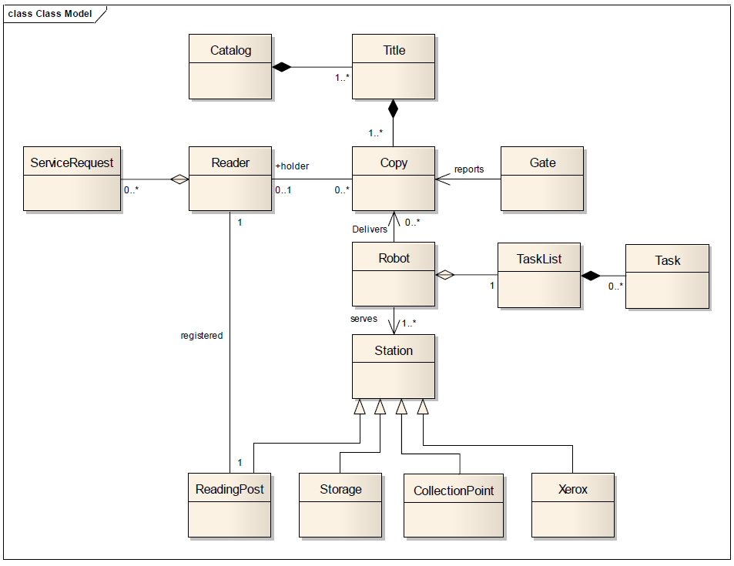

Slide 22
Tips
Don’t try to use all the various notations.
Don’t draw models for everything, concentrate on the key areas.
UML Class Diagrams

Slide 23
Backup
UML Class Diagrams

Slide 24
Analysis Classes
A technique for finding analysis classes which uses three different perspectives of the system:
    The boundary between the system and its actors (Boundary)
    The information the system uses (Entity)
    The control logic of the system (Control)
UML Class Diagrams

Slide 25
Boundary Classes
Models the interaction between the system’s surroundings and its inner workings
  User interface classes
    Concentrate on what information is presented to the user
    Don’t concentrate on user interface details
  System / Device interface classes
    Concentrate on what protocols must be defined. Don’t concentrate on how the protocols are implemented
UML Class Diagrams

Slide 26
Boundary Classes (cont.)
Boundary classes are environment dependent:
  UI dependent
  Communication protocol dependent
UML Class Diagrams

Slide 27
Entity Classes
Models the key concepts of the system
Usually models information that is persistent
Contains the logic that solves the system problem
Is environment independent
Can be used in multiple use cases
For example: Violation, Report, Offender.
UML Class Diagrams

Slide 28
Control Classes
Controls and coordinates the behavior of a use case
Delegates the work of the use case to classes
  A control class should tell other classes to do something and should never do anything except for directing
Control classes decouple boundary and entity classes
Often, there is one control class per use case
UML Class Diagrams

